Slide 1

ModelMuse: Plans for a Stand-Alone GUI for MODFLOW, PHAST and Other Models
Richard B. Winston
May 11, 2007

Slide 2
Outline
Lessons from Argus ONE and PIEs
Current Status of ModelMuse
Live Demo
Planned Changes in ModelMuse

Slide 3
Lessons from Argus ONE and PIEs
Good Features
  Exceptional Flexibility
  Import and Export Capabilities
Bad Features
  Confusing
    Inadequate User Feedback (especially in SutraGUI)
    Too Many Options (especially in MODFLOW GUI)
    Presentation is sometimes confusing (especially in MODFLOW GUI)
    Requires programming skills
  Slow
  Poor Graphics
  Too Much Manual Editing

Slide 4
Expressions: Good and Bad
Powerful
  Expressions allow data linkage
Flexible
  Expressions allow sophisticated data processing
Difficult
  Expressions require user programming
    Users are not programmers
    Complicated Expressions are confusing
    Debugging Expressions is difficult
Annoying
  Evaluating Expressions is slow

Slide 5
Export Templates: A Necessary Evil?
Powerful
  Export Templates allows export of data in a user-defined format
  Some capabilities are only available through Export Templates
  Export Templates are required for Argus ONE act as a preprocessor
Confusing
  Requires user programming
  Most users don’t know that Export Templates exist
  Almost no users can create an Export Template themselves

Slide 6
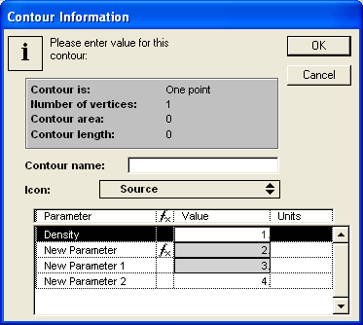
Inadequate User Feedback: 1
What does the gray background in some fields mean?
What does “f_{X}” mean?
Why can’t the “2” be changed while the “3” can be changed?
Why can’t anything besides the values be changed?
Does the “1” come from an Expression or a Contour value.

Slide 7
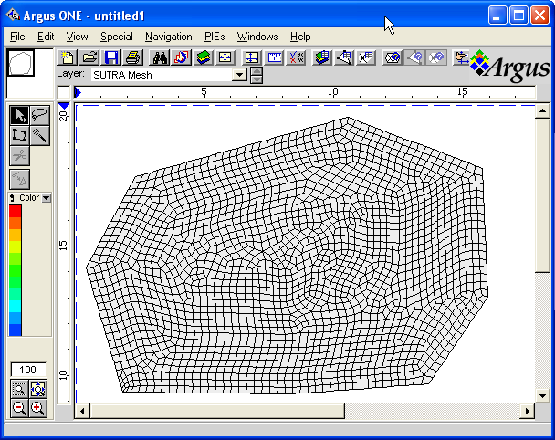
Inadequate User Feedback: 2
Does this SUTRA mesh represent a 2D or 3D model?
If it is a 3D model, what does the mesh look like in 3D?
If it is a 3D model, is the mesh a valid mesh?

Slide 8
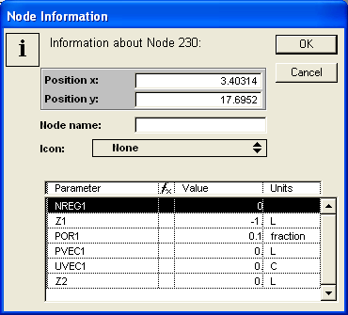
Inadequate User Feedback: 3
In this 3D SUTRA model, Z1 < Z2 which means that the mesh is invalid. Why is
Z1 < Z2?

Slide 9
Inadequate User Feedback: 4
In this 3D SUTRA model, what is the permeability distribution?

Slide 10
Inadequate User Feedback: 5
In this 2D SUTRA model, what is the porosity distribution? (Porosity is defined at nodes.)

Slide 11
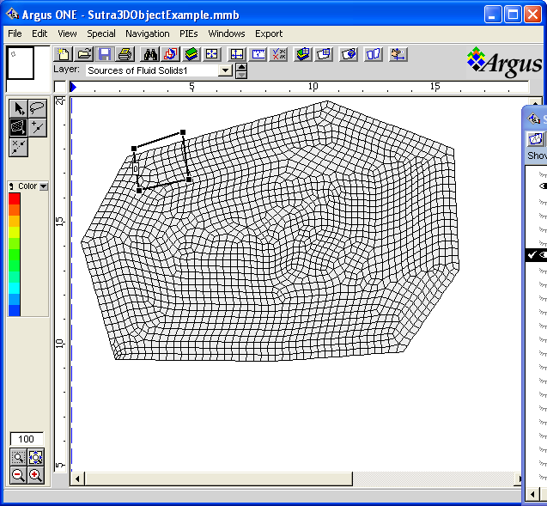
Inadequate User Feedback: 6
In this 3D SUTRA model, the closed contour represents a 3D solid. What does the solid look like in 3D?

Slide 12
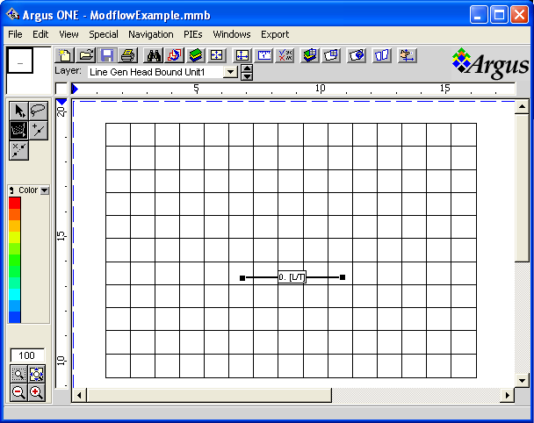
Inadequate User Feedback: 7
In this model, what is the conductance of each General-Head Boundary cell?
In this model, how does the associated head in the GHB cells change over time?

Slide 13
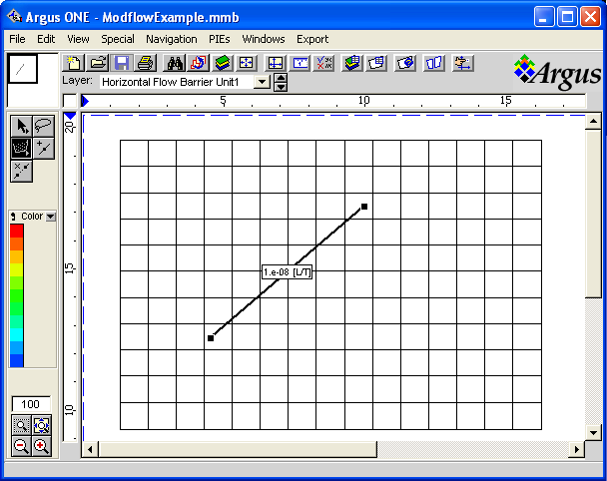
Inadequate User Feedback: 8
In this MODFLOW model, the contour represents a Horizontal Flow Barrier.
  Where exactly will the barriers be placed?
  What will the barrier conductance be between each pair of cells?

Slide 14
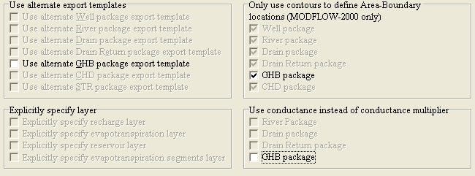
Too Many Options
In this MODFLOW model, there are three different options regarding the GHB package.
  How will each of the 6 possible combinations of options affect the input file for the GHB package?
  Why is the “use only contours” option disabled if the “alternate export template” option is selected?

Slide 15
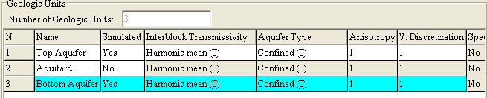
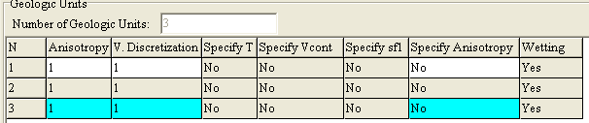
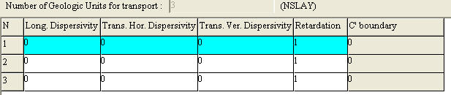
Confusing Presentation of Data: 1
The data about geologic units is too dispersed:
  Users must scroll right on the table in the geology tab to see some of it
  The rest is in a separate table under the GWT

Slide 16
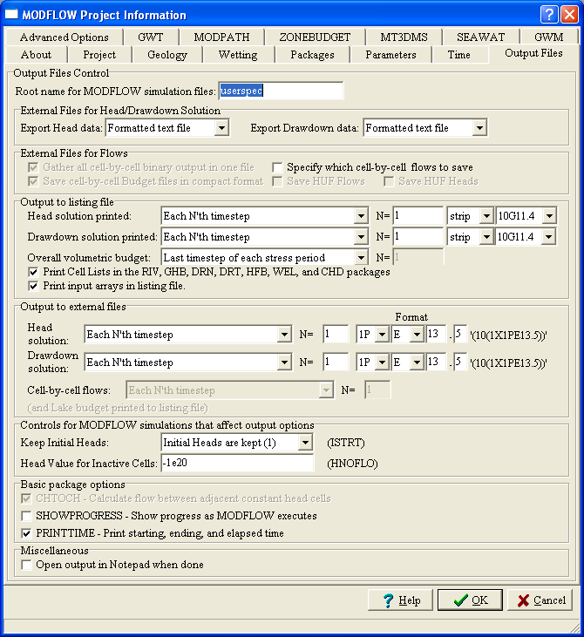
Confusing Presentation of Data: 2
Too many options are displayed together
Some probably don’t belong here (for example HNOFLO)

Slide 17
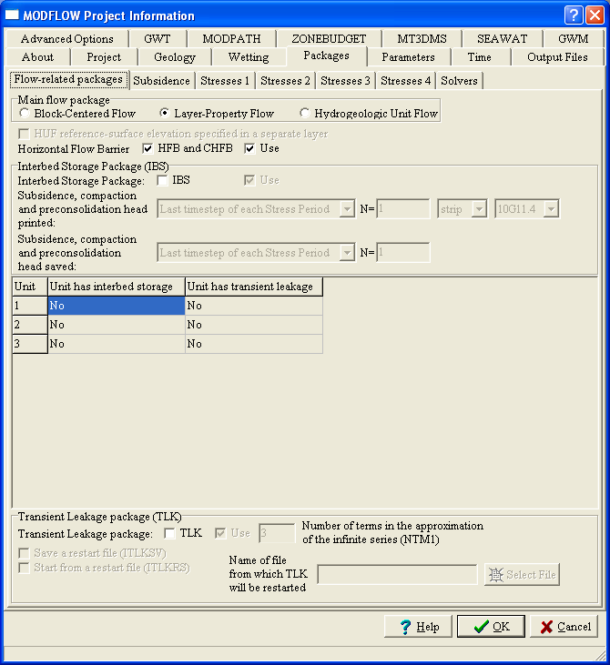
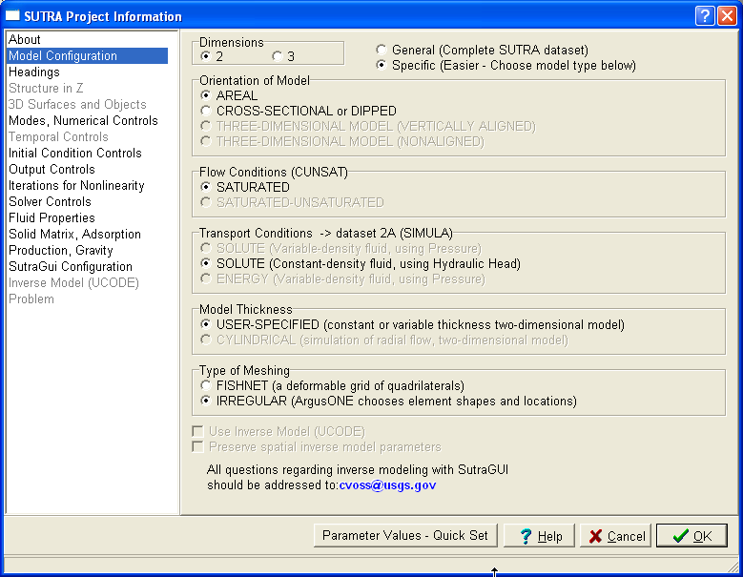
Confusing Presentation of Data: 3
The MODFLOW GUI has too many tabs.
SutraGUI has a better navigation mechanism

Slide 18
Speed
Speed is an issue in Argus ONE
  Exporting data can take a long time
  Redrawing the screen can take a long time
  Making changes in the Layer Properties dialog box can take a long time
Exporting Data and Redrawing the screen are slow because Expressions must be evaluated
Making changes in the Layer Properties dialog box is slow for no good reason

Slide 19
Poor Graphics
Everyone agrees that the graphics in Argus ONE are poor
They need to be of publication quality
Exactly what is meant by “good” graphics is not clear (at least to me).
“Good” graphics might need to include
  User defined text wherever desired
  A color legend under the control of the user
  Ability to control line thickness and color
  Antialiased lines and text
  Better control of the area to be printed.
  Print preview
Notes:
Maybe I should learn more about graphic arts

Slide 20
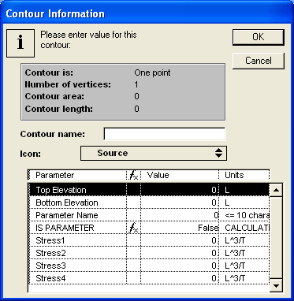
Too Much Editing
For transient data, each data value must be entered individually

Slide 21
Current Status of ModelMuse: Completed: 1
The MODFLOW Grid can be created and edited.
Objects (similar to Argus ONE contours) can be used to set properties of cells in the grid.
There is no equivalent to Argus ONE layers; Objects can set values of any data set
Interpretation method is defined separately for each object
Formulas (equivalent to Argus ONE Expressions) can be defined for each object rather than on layers

Slide 22
Current Status of ModelMuse: Completed: 2
Can import Shapefiles, DXF files, Bitmaps, and other formats
Undo, Redo implemented
The grid can be colored using data sets including transient data sets.
The Status Bar and the Grid Value dialog box show how a particular data value was assigned
Formulas are evaluated only at cells and are not re-evaluated until necessary
No equivalent to export templates is planned

Slide 23
Current Status of ModelMuse: Completed: 3
The Formula Editor has formula diagrams to make understanding complex formulas easier
Global Variables have been added
The following input files can be generated: BAS, DIS, MULT, ZONE, LPF, CHD, RCH, WEL, DRN, DRT, ETS, EVT, GHB, LAK, RES, RIV, and PCG
Data sets for the above can be displayed spatially
Multiple values can be specified easily by cutting and pasting from a spreadsheet or by editing several cells in a table simultaneously.

Slide 24
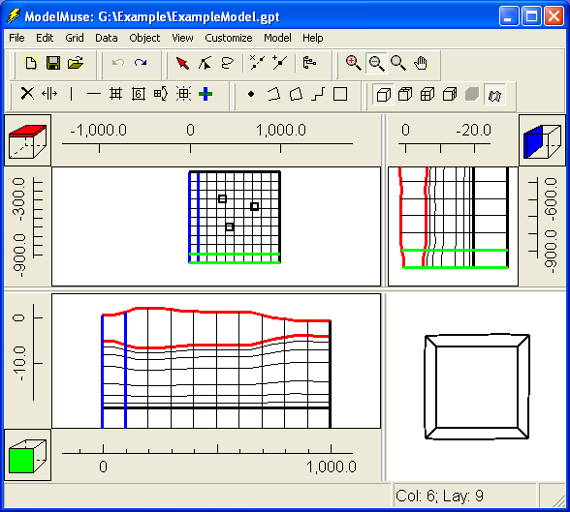
Live Demo

Slide 25
Plans for ModelMuse: 1
Highest Priority
  Support for the remainder of the MODFLOW-2005 packages should be added including the Observation Process
  Draw objects in 3D and in side views
  Add post-processing
  Add Help

Slide 26
Plans for ModelMuse: 2
Lower Priority
  Several dialog boxes need to be changed
  Cut, Copy, and Paste need to be added
  Print needs to be added
  Add support for UCODE-2005
  Improve graphics (How?)
  Possibly allow UCODE-2005 to use “Global Variables” in ModelMuse as parameters to be estimated
  Add local variables?

Slide 27
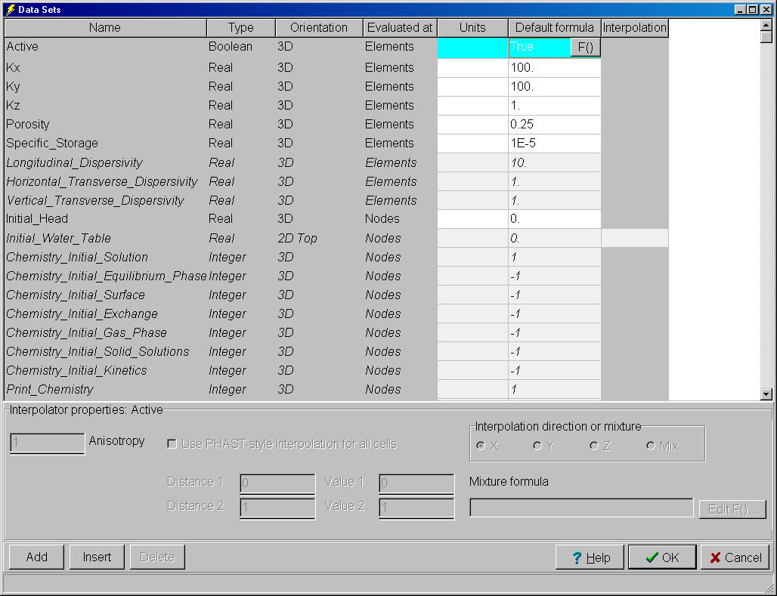
Data Sets Dialog Box
Table will be replaced with tree control
Data set properties will be set in edit controls
The dialog box will end up being much smaller
Unused data sets will be indicated by their position in the tree rather than by background color and italic font as is the case currently.
The user will be able to group related data sets.

Slide 28
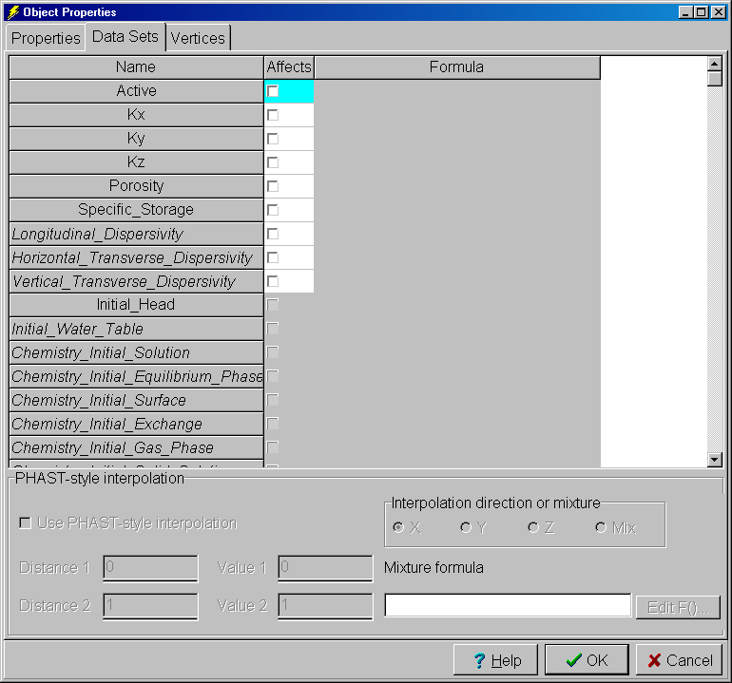
Object Properties Dialog Box
The Data Sets tab will be changed to use a tree control as in the Data Sets dialog box.

